Slide 1
Palermo
Marcos Medrano II

Slide 2
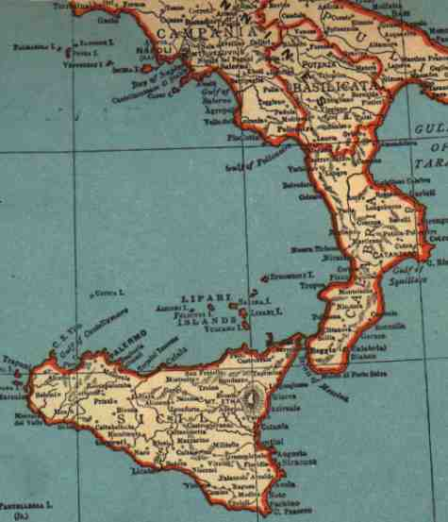
Geographical Location
Palermo, Italy
It lies on the island's northern coast, 200 miles south of Naples.
Palermo has shipbuilding, food-processing, and other manufacturing industries
Largely a trade and export center.

Slide 3
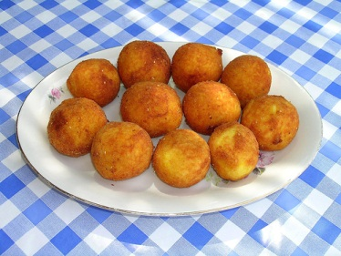
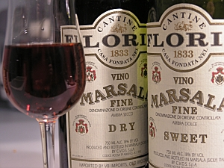
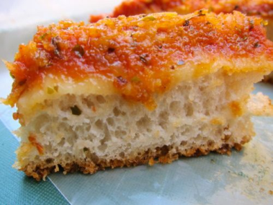
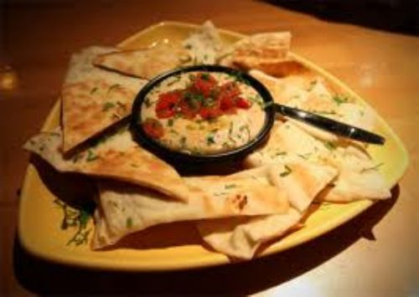
La Cucina
Arancine are rice balls that are filled in with either meat or cheese in fried dough.
Marsala is a wine with an alcohol content of around 20%. It is usually made from Grillo, Catarratto, or Inzolia grapes.
Sfincione is a thick pizza made with onions, sometimes anchovies, and tomatoes, usually served in bakeries
Panella is a thin paste made of crushed or powdered ceci (garbanzo) beans and served fried.

Slide 4
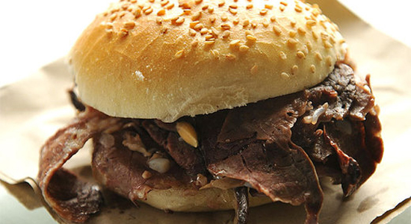
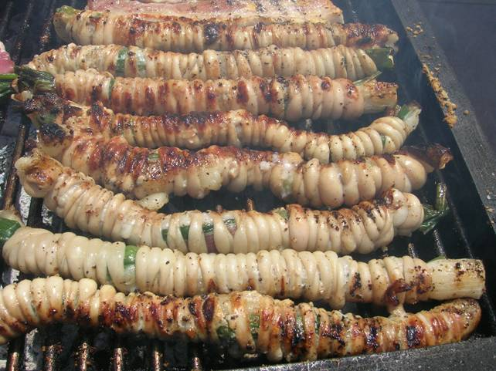
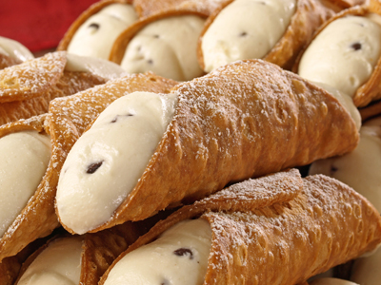
La Cucina (cont.)
Pane con milza (veal spleen sandwiches): traditionally made with lamb or goat.
Stigghiola: seasoned and barbecued lamb or kid (baby goat) intestines served on a skewer
Cannoli: tubular crusts with ricotta and sugar filling

Slide 5
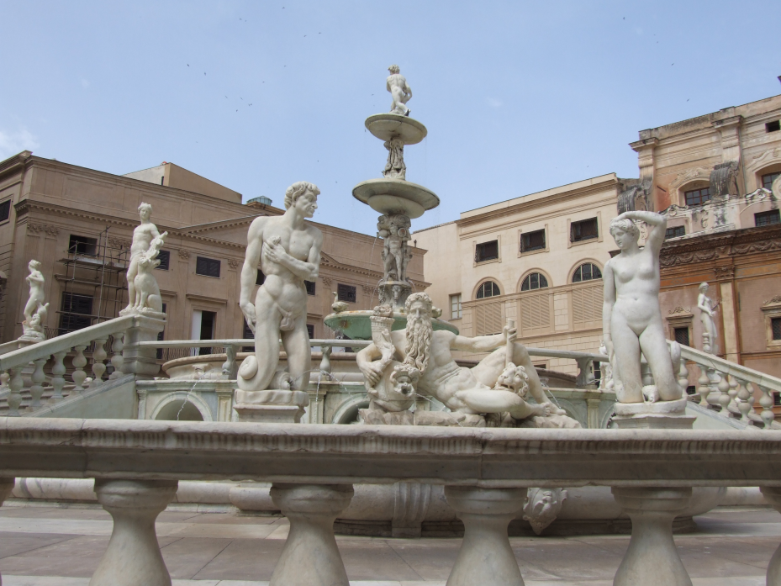
Historical Landmarks
(La pietra miliare nella storia)
Fontana Pretoria
Located at the heart of the Piazza Pretoria in Palermo.
It was created in the mid-16th century by Camilliani, a sculptor (scultore) from Florence
Fontana Pretoria was referred to as the “fountain of shame” because many people felt uncomfortable with naked (nudo) sculptures and monsters (mostri).

Slide 6
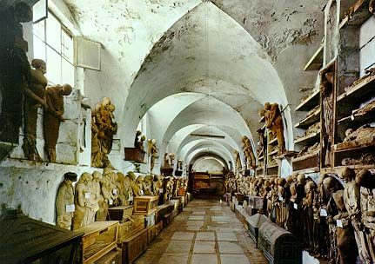
Historical Landmark (cont.)
Capuchin Catacombs (catacombe)
In 1599, Capuchin monks (monaci) discovered that their catacombs (underground cemeteries) contained a preservative that mummified the deceased (defunto).
People may chose to be buried here.

Slide 7
History (La Storia)
8000 BC- A race (razza) of people called the Sicani inhabited (abitato) Palermo
734 BC- Conquered (conquistato) by the Phoenicians from ancient (antico) Canaan (present day Lebanon/Israel)
831 AD- Saracens (North African Muslims) seize the land and renamed Balharm
1072 AD- Conquered by the Normans
1192- Controlled (controllata) by the Holy Roman Empire
1732- United (unito) with the Kingdom (regno) of Naples
1860- Annexed (allegato) by the Kingdom of Italy
1943- Bombed (bombardata) by the Allies during World War II (Seconda Guerra Mondiale)

Slide 8
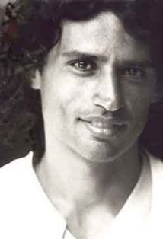
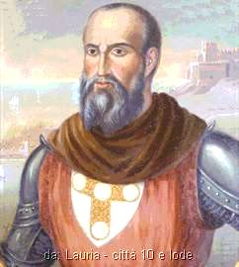
Famous People (Le persone famose)
Enrico Lo Verso (
He studied acting at the Centro Sperimentale di Cinematografia and INDA (Istituto Nazionale del Dramma Antico)
Di Lauria Ruggiero (c. 1250- 1304/05)
Italian admiral (ammiraglio) in the service of Aragon and Sicily who won important naval (navale) victories (vittorie) over the French Angevins (Plantagenet dynasty [dinastia] of England from 1154 to 1399 )

Slide 9
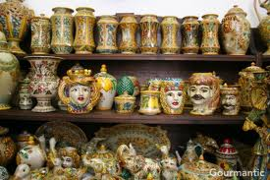
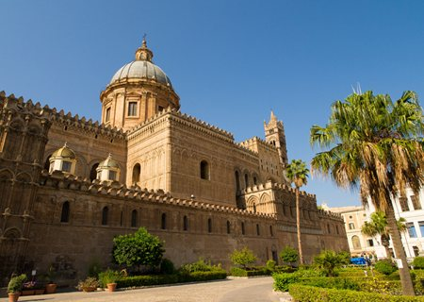
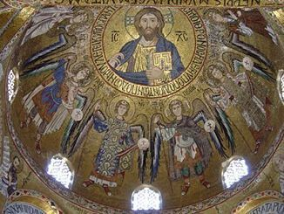
Art (L’arte)
Ceramic Art: terra cotta (baked earth) -This art was popular (popolare) with the Sicanians, Phoenicians, Greeks and other ancient peoples of Sicily
Buildings (edifci): Arab-Norman influenced buildings, some decorated (decorato) with Byzantine-style mosaics (mosaici)

Slide 10
Festivals (Le Festività)
U Fistini Festival in Palermo:
This festival takes place between the 10th and 15th July and is dedicated to St. Rosalia, the patron saint of Palermo.
There are generally five days of celebrations that includes dancing, music, and drinking
formal highlight of the festival is a street parade where the relics of St. Rosalia are displayed through the streets of the city.
Palermo di Scena (Scene) Festival:
This festival is staged through the summer months in Palermo
Involves various occasions including several musicals, theatrical performances, and cinema screenings.

Slide 11
Works Cited
"Sicilian Cuisine - See Palermo and Western Sicily." Sicilian Cuisine - See Palermo and Western Sicily. N.p., n.d. Web. 09 July 2012. <http://www.seepalermo.com/cuisine.htm>.
"Capuchin Catacombs, Palermo." Capuchin Catacombs. N.p., n.d. Web. 05 July 2012. <http://www.sacred-destinations.com/italy/palermo-capuchin-catacombs>.
"History of Palermo." Palermo Italy, City of Palermo Sicily. N.p., n.d. Web. 05 July 2012. <http://palermo.com/history-of-palermo/>.
"Ruggiero Di Lauria (Italian Admiral)." Encyclopedia Britannica Online. Encyclopedia Britannica, n.d. Web. 05 July 2012. <http://www.britannica.com/EBchecked/topic/332453/Ruggiero-di-Lauria>.
"Palermo." , Italy. N.p., n.d. Web. 09 July 2012. <http://www.sacred- destinations.com/italy/palermo>.
"Interesting Facts & Information: Tourism, Travel, Culture, Language, Business, People. Â» Blog Archive Â» Italy Festival Guide: Festivals in Palermo." Interesting Facts & Information: Tourism, Travel, Culture, Language, Business, People. Â» Blog Archive Â» Italy Festival Guide: Festivals in Palermo. N.p., n.d. Web. 05 July 2012. <http://www.kwintessential.co.uk/articles/italy/italy-festival-guide-festivals-in- palermo/346>.

